Slide 1
Web Design Fundamentals /
Basic Web Design
WEB HOSTING

Slide 2
What is a Web Server?
The collection of all your web pages is called
your web site.
To let others view your web pages, you must
publish your web site.
Notes:
Just for review….

Slide 3
What is a Web Server?
To publish your work, you must
copy your site to a web server.
Your own PC can act as a web server if it is
connected to a network.
Most common is to use an
Internet Service Provider (ISP).
Notes:
Just for review….

Slide 4
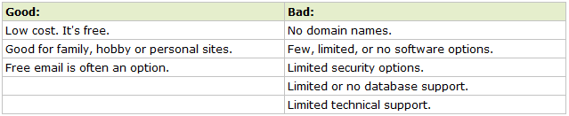
HOST TYPES
1. Free Hosting
Best suited for small sites with low traffic, like personal sites. It is not recommended for high traffic or for real business. Technical support is often limited, and technical options are few.

Slide 5
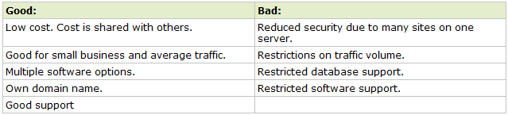
HOST TYPES
2. Shared(Virtual) Hosting
Your web site gets its own domain name, and is hosted on a powerful server along with maybe 100 other web sites.

Slide 6
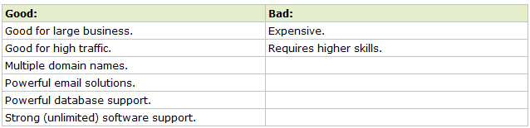
HOST TYPES
Dedicated Hosting
The most expensive option. This option is best suited for large web sites with high traffic, and web sites that use special software.

Slide 7
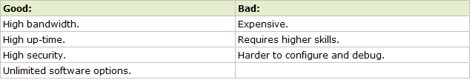
HOST TYPES
4. Collocated Hosting
Collocation means "co-location". Collocated hosting lets you place your own web server on the premises (locations) of a service provider.

Slide 8
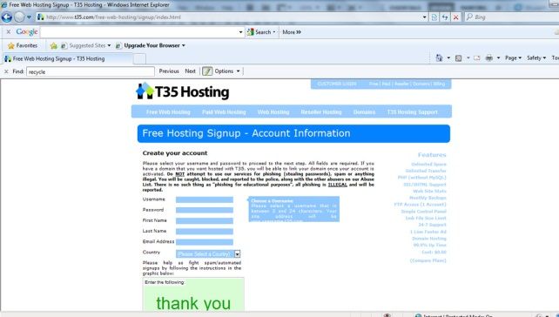
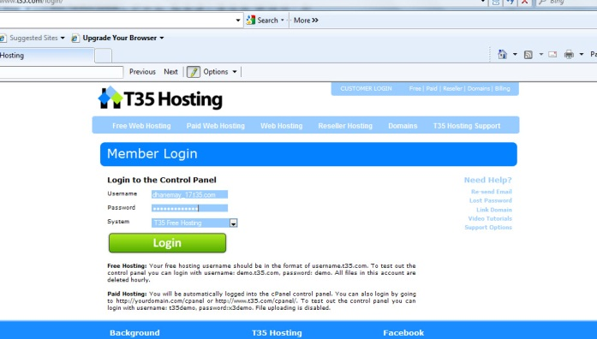
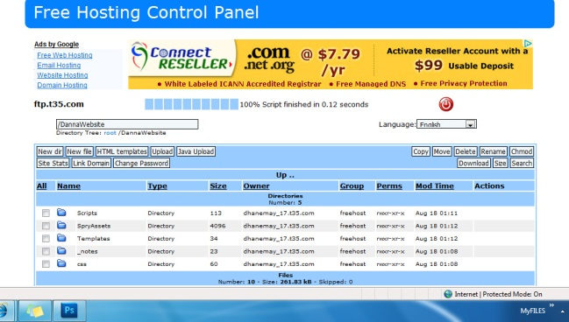
Registration to a free hosting site
1. Sign up and register for sub domain
2. Email notifications will be sent for cpanel login details
3. Upload your website to the root folder

Slide 9
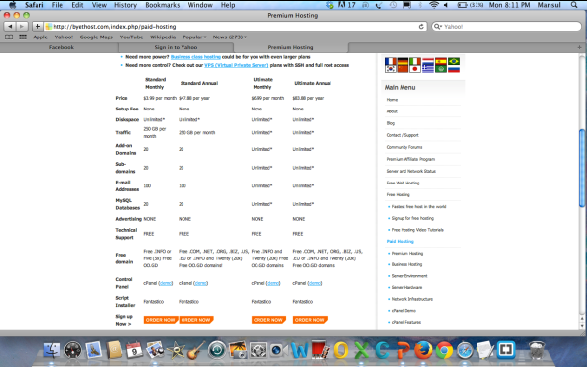
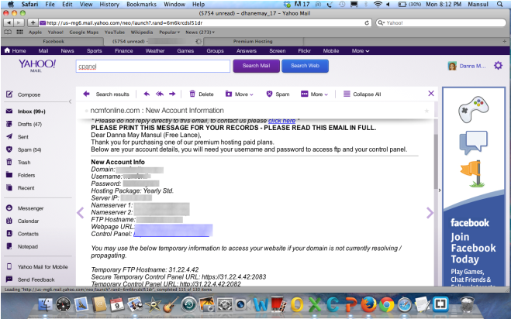
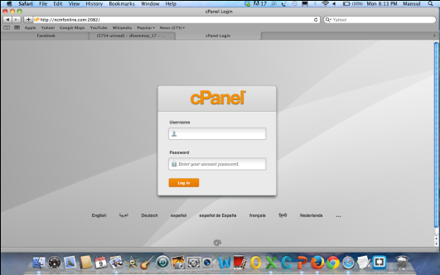
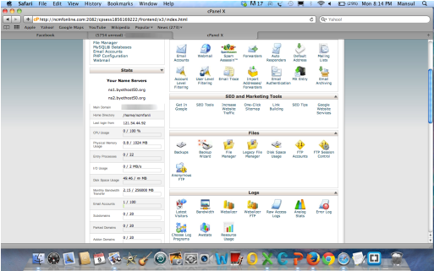
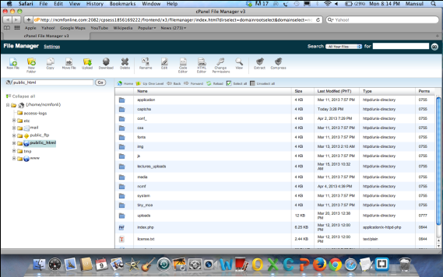
Shared Hosting
1. Select for package and register a domain name
2. After successful payment, account details will be sent through email.
3. Login
4. Manage files in File Manager
5. Upload your website

